Slide 1

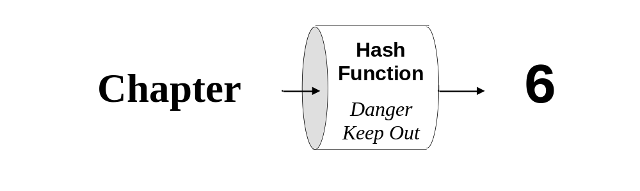
Java
Methods AB
TM
Maria Litvin
Gary Litvin
Data Structures
Maps only
Copyright © 2003-2004 by Maria Litvin, Gary Litvin, and Skylight Publishing. All rights reserved.

Slide 2
Objectives:
Map interfaces and implementations!
Learn how to use the TreeMap, and HashMap classes
Notes:
HashSet is a different implementation of the Set interface. It uses a hash table instead of the binary search tree used in TreeSet.

Slide 3
Map<K, E>
A map represents a correspondence between a set of keys and a set of values
Think function, for every K, there is one E
but several K may map to the same E
The java.util.Map<K, E> interface represents a map
java.util.TreeMap<K, E> implements a map as a BST for keys
TreeMap<K, E> assumes that the keys are Comparable objects (or a comparator is passed to the TreeMap<K, E> constructor)
Notes:
The word “Map” comes from the mathematical term “mapping,” which is a function from one set into another, here from the set of keys into the set of values.

Slide 4
Properties of a Map
Each key can have only one value associated with it – Like a FUNCTION
The same value can be associated with different keys
Strictly speaking, a key can be associated with null, but this is never done – except maybe at …..

Slide 5
Some of the Map<K, E>
(and TreeMap<K, E>) Methods
  Object put (K key, E value);
  Object get (K key);
  boolean remove (K key);
  boolean containsKey (K key);
  Set<K> keySet ( );
Returns the set of all keys
Notes:
The keySet method does not copy the set — it just returns a reference to the set of keys in the map structure.

Slide 6
Lookup Tables
The value of a key is directly translated into an array subscript using a simple formula
The array stores the values associated with keys
The mapping from all the keys into integer subscripts must be unambiguous
The subscript that corresponds to a key must fall into the valid range (from 0 to array.length - 1)
Notes:
A lookup table may waste space, but it provides instantaneous access to the data — no search is needed.

Slide 7
Applications of Lookup Tables
Data retrieval
Data compression and encryption
Tabulating functions
Color mapping

Slide 8
Hash Tables
The value of a key is translated into an array subscript using a hash function
The subscript that corresponds to a key must fall into the valid range
The hash function can map different keys onto the same element in the array — this situation is called collision
Notes:
Hash tables build upon the lookup table idea, only in a hash table several values can fall into the same location.

Slide 9
Hash Tables (cont’d)
The hash function should map the keys onto the array subscripts randomly and uniformly
A well-designed hash table and hash function minimize the number of collisions
There are two common techniques for resolving collisions: chaining and probing
Notes:
Chaining is more common. The Java library uses chaining.

Slide 10
java.util.HashMap<K, E> Classes
Map interfaces, using hash tables
May be more efficient for searching than TreeSet and TreeMap
Notes:
But HashSet and HashMap may waste some space.

Slide 11
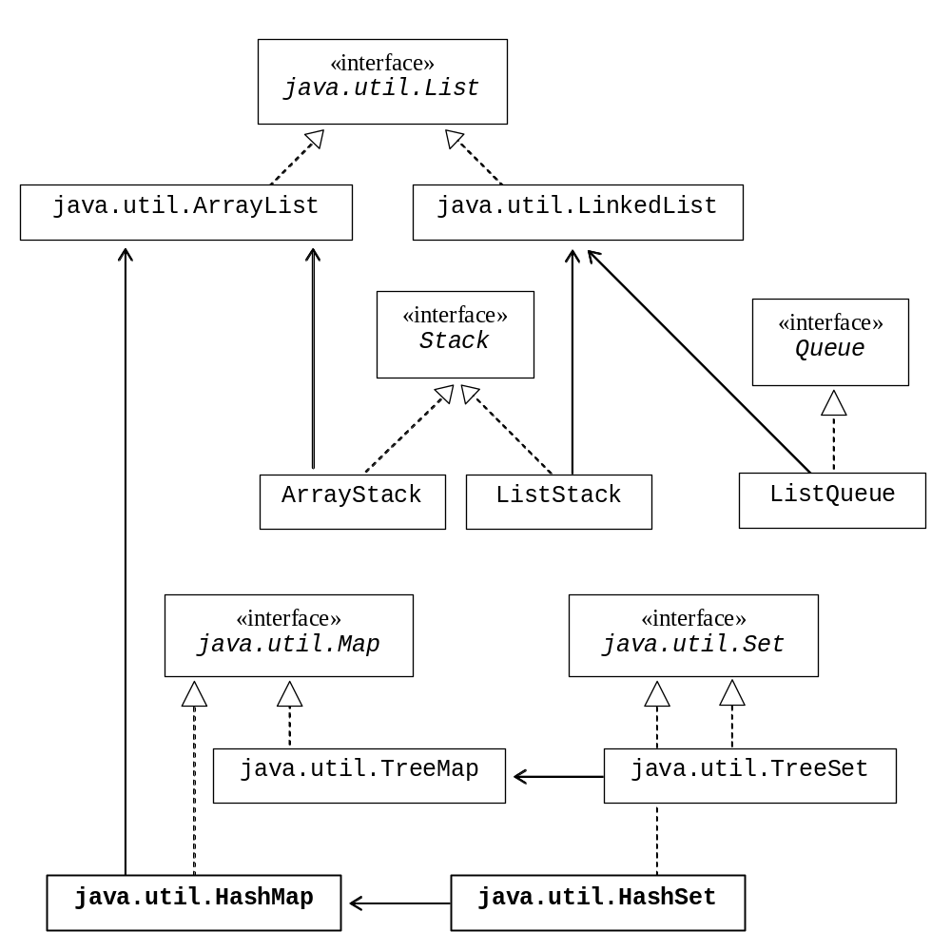
The Big Picture
Notes:
Actually HashMap does not use ArrayList: it uses a built-in array and keeps track of the table size and capacity itself. HashSet is implemented as a special case of a HashMap.

Slide 12
HashMap (cont’d)
Collisions are resolved through chaining
The sizes of buckets must remain relatively small
Load factor:
Total number of values
Number of buckets
= Load factor
Notes:
0.75 is considered a reasonable load factor, which means the number of values does not exceed 3/4 of the number of buckets.

Slide 13
HashMap
Fine tuning:
  Load factor too large → lots of collisions
  Load factor too small → wasted space and slow iterations over the whole set
If the load factor exceeds the specified limit, the table is automatically rehashed into a larger table; if possible this should be avoided

Slide 14
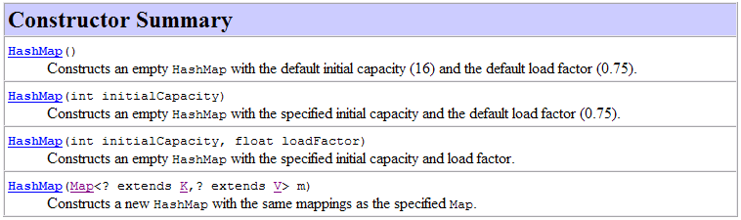
The HashMap Class
Map<K, E> m = new HashMap<K, E>();
Notes:
Only the no-args constructor is needed for the AP exams.

Slide 15
Some of the Map<K, E>
(and HashMap<K, E>) Methods
  E put (K key, E value);
  E get (Object key);
  E remove (Object key);
  boolean containsKey (Object key);
  Set<K> keySet ( );
Returns the Set (HashSet) of all keys
Notes:
The same methods as in TreeMap.

Slide 16
HashMap
keys in a HashMap must have a reasonable int hashCode ( ) method that redefines Object’s hashCode and helps to calculate the hashing function
The hashCode method returns an int from the entire int range; it is later mapped on the range of subscripts in a particular hash table
String, Integer, Double each have a reasonable hashCode defined
Notes:
The transformation of the value returned by hashCode() into the actual bucket index may involve some additional hashing. Then the index must be mapped onto the range of the indices in the table: from 0 to size - 1. This involves truncation. The Java library uses tables of the size equal to a power of two and doubles the size of the table if it needs to expand the table.

Slide 17
TreeMap<K, E>
Is implemented as a BST for keys
compareTo (or comparator’s compare) for keys is used by the put, get, containsKey, and remove methods
The keySet method returns a TreeSet<K, E>
Notes:
Map map;
...
Iterator iter = map.keySet().iterator();
This iterator traverses the set of keys in ascending order.

Slide 18
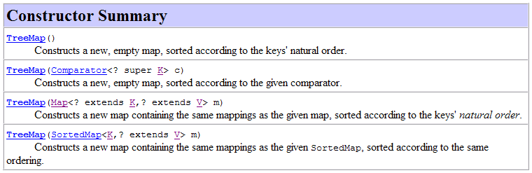
TreeMap (cont’d)
Never mind...
Map<K, E> m = new TreeMap<K, E>();
Notes:
Only the no-args constructor is needed for the AP exams.

Slide 19
TreeMap Example:
Traversing all Key-Value Pairs
import java.util.*;
...
// Map<K, E> map = new TreeMap<K, E>();
Map map<Integer, String> = new TreeMap<Integer, String>();
map.put(new Integer (1), “George Washington”);
...
Iterator<Integer> iter = map.keySet( ).iterator ( );
while ( iter.hasNext( ) )
{
Integer key = iter.next( );
String name = map.get(key);
System.out.println(key + " : " + name);
}

Slide 20
TreeMap Example:
Traversing all Key-Value Pairs
Enhanced for loop
import java.util.*;
...
// Map<K, E> map = new TreeMap<K, E>();
Map map<Integer, String> = new TreeMap<Integer, String>();
map.put (new Integer (1), “George Washington”);
...
for ( Integer key : map.keySet( ) )
{
String name = map.get(key);
System.out.println(key + " : " + name);
}

Slide 21
HashMap Example:
Traversing all Key-Value Pairs
import java.util.*;
...
// Map<K, E> map = new HashMap<K, E>();
Map<Integer, String> map = new HashMap<Integer, String >();
map.put(new Integer (1), “George Washington”);
...
Iterator <Integer> iter = map.keySet( ).iterator ( );
while ( iter.hasNext( ) )
{
Integer key = iter.next( );
String name = map.get(key);
System.out.println(key + " : " + name);
}

Slide 22
HashMap Example:
Traversing all Key-Value Pairs
Enhanced for loop
import java.util.*;
...
// Map<K, E> map = new HashMap<K, E>();
Map<Integer, String> map = new HashMap<integer, String >();
map.put(new Integer (1), “George Washington”);
...
for ( Integer key : map.keySet( ))
{
String name = map.get(key);
System.out.println(key + " : " + name);
}

Slide 23
Map: one more example:
import java.util.*;
...
// Map<K, E> map = new (Tree/Hash)Map<K, E>();
Map<Integer, Set<String>> map = new ????Map<integer, Set<String> >();
SomeDataStructure<String> mySet = new ????<String>();
mySet.add(“AP CS AB”); /// assumes add works in SomeDataStructure
mySet.add(“AP USH”);
mySet.add(“AP ES”);
…..
map.put(new Integer (1), mySet);
SomeDataStructure temp = map.get(new Integer(1));
temp.add(“PE”);
// What is the contents of map.get(new Integer(1)); now????

Slide 24
java.util.Map<K,V> - keyset
The keyset is backed by the map, so changes to the map are reflected in the set, and vice-versa.
The keyset supports element removal, which removes the corresponding mapping from this map, via the Iterator.remove, Set.remove, removeAll, retainAll, and clear operations.
It does not support the add or addAll operations.
What does this mean – If you are iterating over the keyset, the only why to modify the keys is with the above methods
Notes:
Only the no-args constructor is needed for the AP exams.

Slide 25
Consistency
HashSet / HashMap first use hashCode, then equals
TreeSet / TreeMap use only compareTo (or a comparator)
For consistent performance, these methods should agree with each other:
  x.equals(y) ⇔ x.compareTo(y) == 0
  x.equals(y) ⇒ x.hashCode( ) == y.hashCode( )
Notes:
Thus, it is a good idea for Comparable objects to also redefine the equals and hashCode methods.

Slide 26
Review:
What is the main difference between a lookup table and a hash table?
How is hash table performance affected when the load factor is too high? Too low?
What happens to a HashSet or a HashMap when the load factor exceeds the specified limit?
HashSet’s no-args constructor sets the initial capacity to 16 and the load factor limit to 0.75. How many values can be stored in this table before it is rehashed?
Notes:
What is the main difference between a lookup table and a hash table?
In a lookup table, only one value can be placed into each slot; in a hash table several values may be placed into the same slot.
What is a collision?
A situation where two different values are mapped onto the same entry in the table.
Name two common techniques for resolving collisions.
Chaining and probing.
What is a bucket?
A collection that holds all the values that fall into the same hash table entry.
What is a load factor?
The ratio of the number of values stored in the hash table to the table size.

Slide 27
Review (cont’d):
What is the sequence of values returned by an iterator for a HashSet?
What is the range of values for the hashCode method?
Which method(s) of an object are used to find it in a TreeSet? A HashSet?
Notes:
What is the sequence of values returned by an iterator for a HashSet?
No particular sequence, random.
What is the range of values for the hashCode method?
All integers.
Which method(s) of an object are used to find it in a TreeSet? A HashSet?
TreeSet — compareTo; HashSet — first hashCode, then equals.

Slide 28
Homework
Read Chapter 6 in the book
02. DoraMapHomework.doc
03. Big_O_worksheet.doc

Slide 29
Programs
Look on the K drive for more information about
  AllenWittrySet
  The Morse Code lab
  DorasGreatMapAdventure Part 1
  DorasGreatMapAdventure Part 2

